Slide 1
Garbage Data Filtering
For Social Networking Sites

Slide 2
Team Info.
Name of the Person | R-ID
Peela Hema Harsha Vardhan | R11912124
Nitin Ancha | R11892349
Sai Nymisha Issai | R11892336
Nithish Chandra Vyas Talluru | R11842825
Kandula Thanmayee | R11931869
Sowmya Raavi | R11909388
Kalyani Chittipolu | R11909106
Snehitha Pothina | R11889528

Slide 3
Contents
Topic
Abstract 4
Introduction 5
Existing Method 6
Proposed Implementation 8
Results 10
Conclusion 14

Slide 4
Abstract
Recently, as the use of social network services (SNS) increases in daily modern life, the amount of SNS data generated has become very large. In addition, increasing efforts are being directed at extracting various pieces of information by collecting, processing, and analyzing large amounts of SNS data. While various pieces of information can be extracted from SNS data through big data processing, this is a highly resource-intensive task. Therefore, in order to obtain information from SNS data, a lot of time and material resources are required. In this paper, we propose a data filtering algorithm that filters out garbage data that has no meaning as data among SNS data. The proposed algorithm improves the filtering accuracy by recursive learning based on the initial learning data. Experimental results show that the proposed algorithm has a filtering effect of over 70% on the experimental keywords.

Slide 5
Introduction
Explosive rise in SNS users via mobile devices drives an immense surge in data generation.
SNS platforms contain a diverse array of content, extending beyond social interactions to encompass multifaceted societal opinions.
Challenges in analysis arise from a mix of data types—useful information, advertisements, and irrelevant content within SNS datasets.
A notable research gap exists in the exploration of optimizing data utility before processing large-scale big data sets.
Introducing an innovative algorithm that leverages cyclic and machine learning techniques to effectively refine garbage data within these expansive datasets.
Experimentation will validate the algorithm's effectiveness in improving data filtration within the extensive landscape of SNS datasets.

Slide 6
Existing Method
The existing system encounters challenges in effectively analyzing SNS data due to its complex nature, comprising a mix of valuable content, advertisement data, and information pertinent to the analysis.
Current research in big-data processing emphasizes stable data collection, storage, and processing efficiency within constrained computing resources.
However, within the existing system, there is a lack of comprehensive exploration into pre-processing methodologies before the data analysis phase, leading to limitations in accurately filtering and categorizing the diverse SNS data.
While leveraging Naive Bayes, a widely used probabilistic classification algorithm, the existing system demonstrates limitations in accurately filtering and categorizing the intricate content within SNS datasets.

Slide 7
Cont..
The system faces challenges in effectively distinguishing and categorizing useful data, advertisement content, and information conducive to analysis within the expansive SNS dataset.
As a result, the existing system encounters difficulties in achieving optimal accuracy in filtering and categorizing diverse SNS data, highlighting the need for improved pre-processing methodologies for enhanced data analysis.

Slide 8
Proposed Implementation
The proposed system aims to effectively filter garbage data from big data, enhancing the accuracy and speed of real big data processing by utilizing machine learning techniques.
The system employs specialized algorithms, including Random Forest, Decision Tree, and XGBOOST modules. These modules train and predict test data, facilitating accurate prediction assessments.
Random Forest: It excels in SNS data filtering by leveraging multiple trees for improved accuracy, and robustness against noise and outliers, offering insights into feature importance, and adaptability to imbalanced and evolving datasets, ensuring sustained accuracy in classification.
Decision Tree: It is advantageous in SNS data filtering due to its capability to capture complex relationships, handle noise and outliers, provide interpretability, and adapt to imbalanced datasets, contributing to accurate and versatile data filtering.

Slide 9
Cont…
XG BOOST: Known for effectively handling complex, non-linear relationships, making it suitable for capturing intricate interactions among attributes within SNS data. Handles imbalanced data effectively and adapts well to evolving SNS datasets, ensuring sustained accuracy even as data patterns evolve over time.
The Data Analyzer module plays a crucial role by allowing users to upload test data, utilizing the trained model to categorize tweets into distinct groups—0 (Garbage), 1 (Advertisement), or 2 (Definite).
Integral to the system's assessment capability, the Accuracy Comparison Graph module generates comprehensive graphical representations, comparing the prediction accuracy across all algorithms utilized in the system.

Slide 10
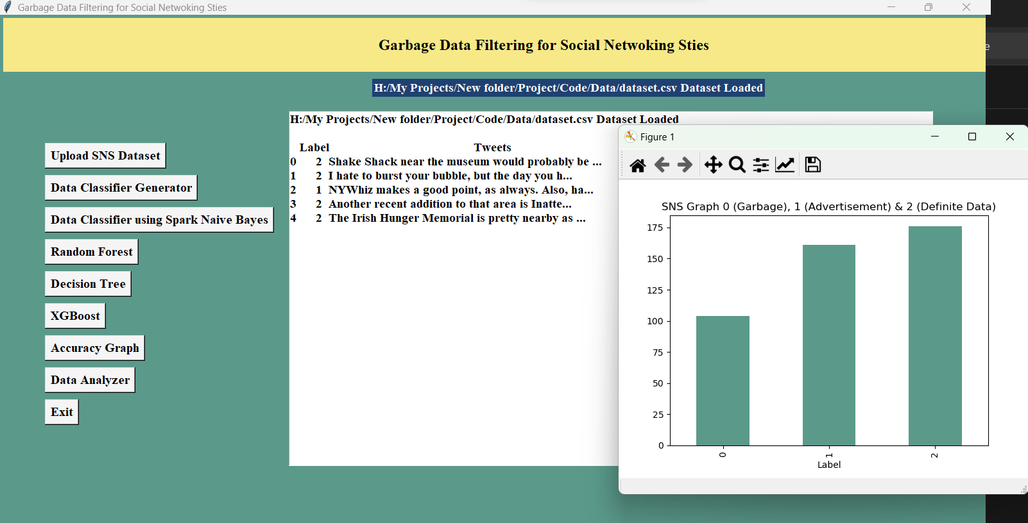
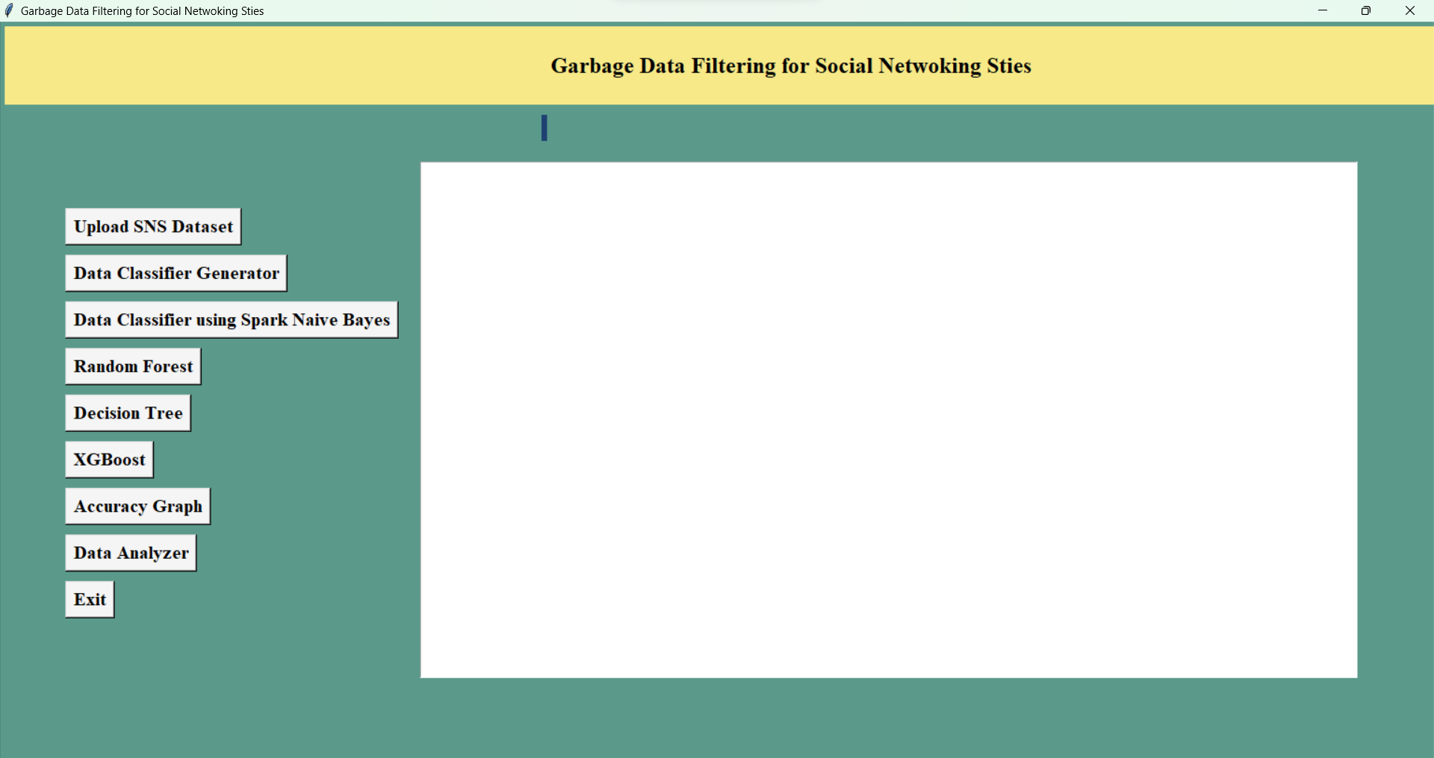
Results

Slide 11
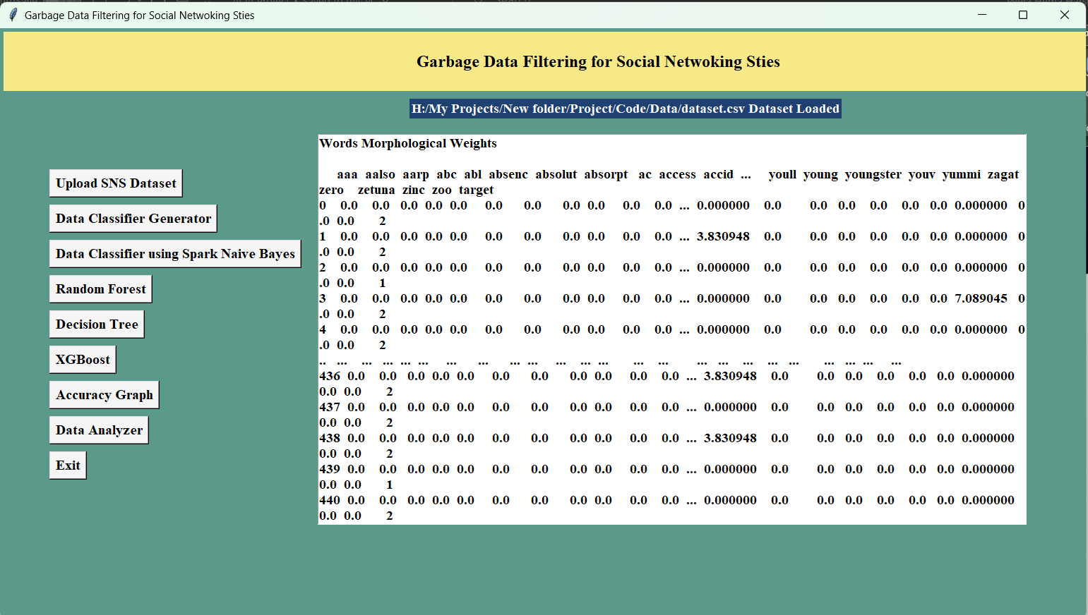
Results

Slide 12
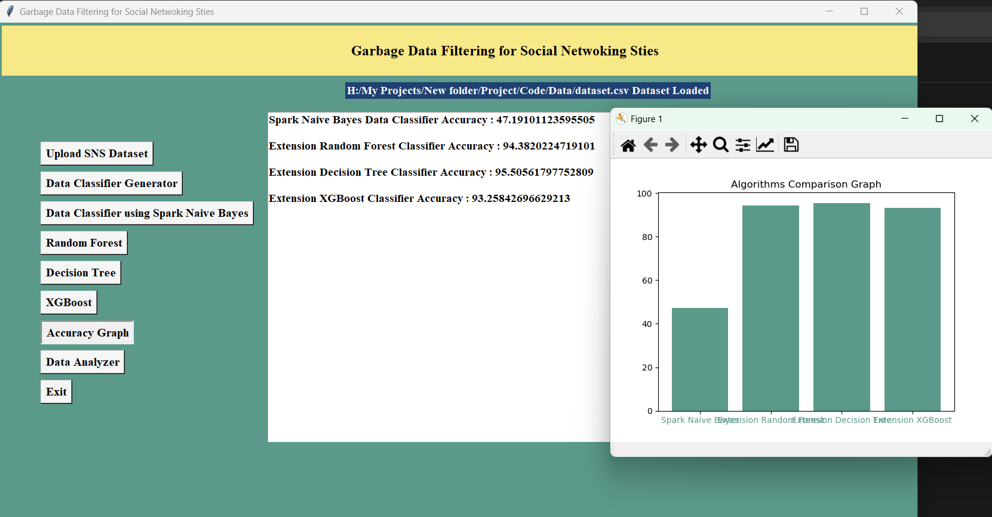
Results

Slide 13
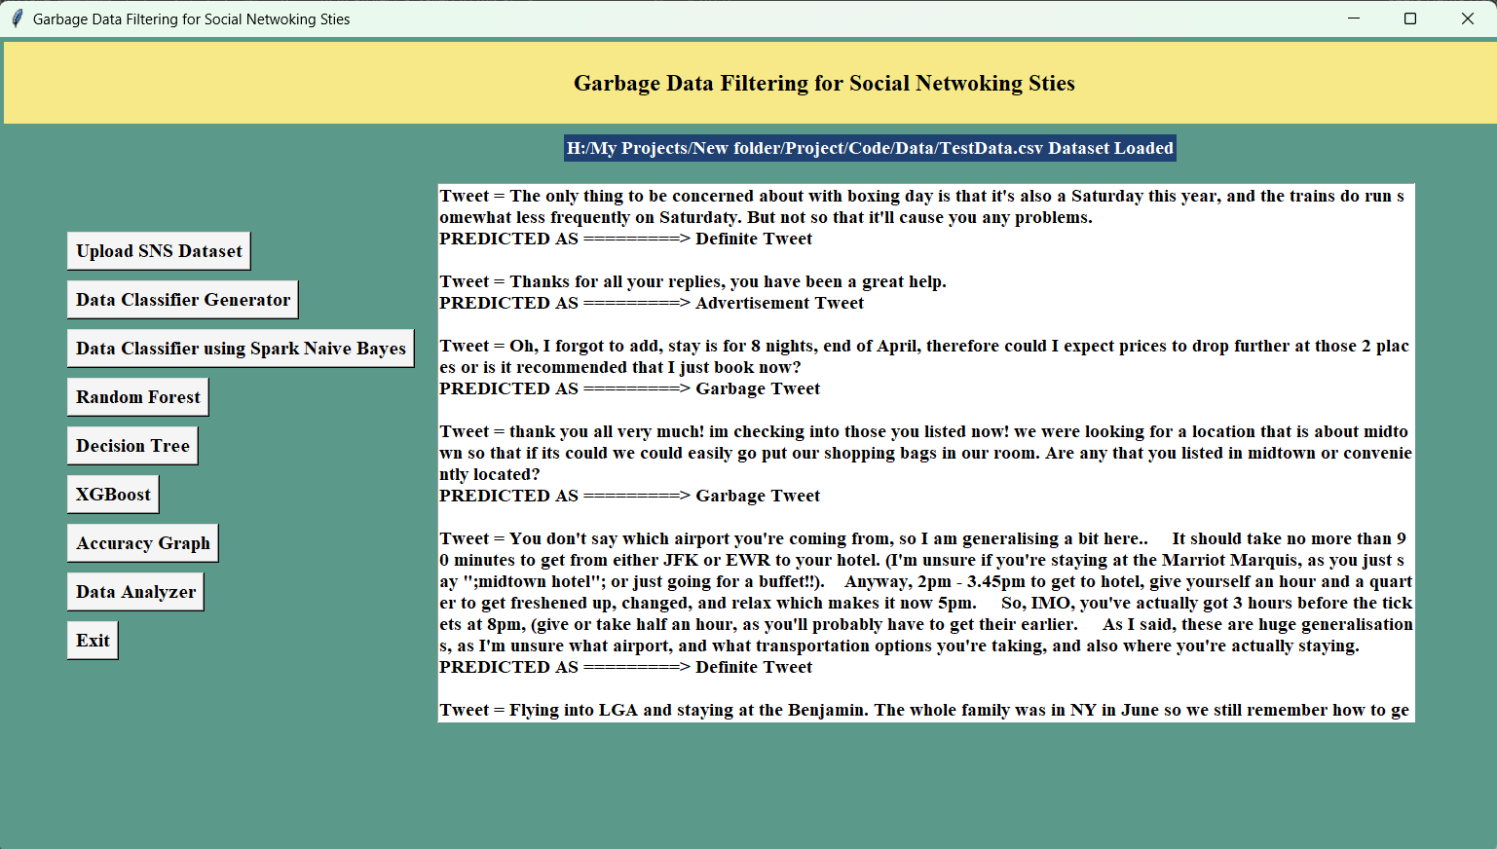
Results

Slide 14
Conclusion
This study introduces an advanced SNS garbage data filtering system using repetitive machine learning techniques, significantly improving the unstructured data analysis within social networking services.
Achieving an impressive accuracy in categorizing SNS data into garbage, advertisement, and definitive categories, this system shows promising applications in big data processing environments.
The study's primary contribution lies in proposing an effective filtering system tailored for efficiently processing valuable information from extensive SNS datasets, offering enhanced efficiency in big data processing systems.
Additionally, the research introduces a novel recursive machine learning approach that employs initial SNS data for filtering and iteratively enhances accuracy by incorporating filtered data in subsequent learning cycles.
These findings highlight potential implications for efficient processing and extracting valuable insights from SNS Big Data, paving the way for applications across various domains requiring precise data categorization and analysis.

Slide 15
Thank you

